Slide 1
Advancements in Information Reteival: Enhancing Query Expansion and Ranking with CORAG
CSCE 5200 Information Retrieval
Abjal Hussain Shaik (11643584)
Hari Krishna Sai Rachuri (11682376)
Tharun Ramula (11706360)
Computer Science and Engineering Department

Slide 2
Problem Statement and Motivation
BM25 and TF-IDF are examples of traditional IR models that depend on keyword matching.
Poor academic paper retrieval results from a lack of contextual comprehension.
Cannot handle
Academic terms (such as "semantic drift" and "protein folding")
Long or unclear questions
Motivation: Increase academic information retrieval's latency, correctness, and relevancy.

Slide 3
Keyword Match
Low Relevance
Traditional IR System
Query Expansion
+
Hybrid Search
High Relevance
CORAG

Slide 4
Summary of Proposed Methodology
CORAG: chain of retrieval augmented generation
Three key components:
BM25 >> Lexical search
FAISS >> Semantic vector search
FLAN-T5 / BERT >> Query expansion
Hydrid Retrieval + Semantic Reranking improves ranking quality

Slide 5
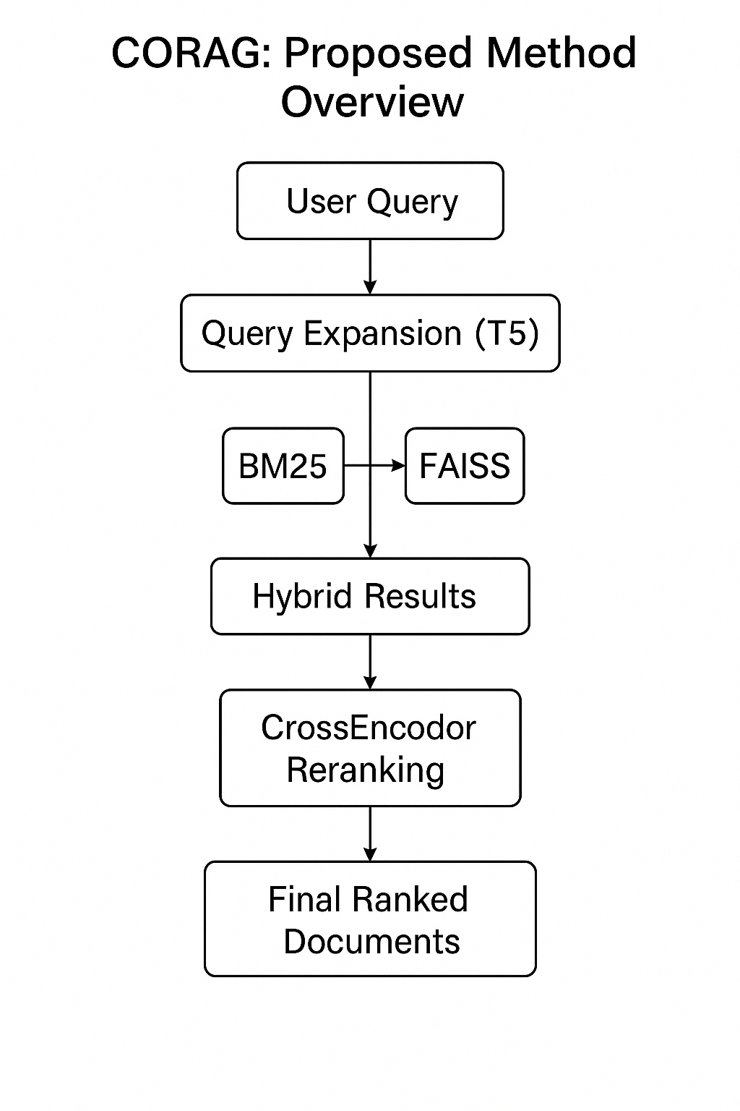

Slide 6
Updates:
Used CrossEncoder to introduce semantic reranking (MSMARCO).
For improved query expansion, FLAN-T5 was used in place of basic T5.
Modified hybrid retrieval to prevent redundancy and duplication.
Component | Before | After
Query Expansion | T5 | FLAN-T5
Reranking | None | CrossEncoder
Hybrid Retrieval | Basic Merge | Weighted hybrid

Slide 7
Dataset and Preprocessing
Source: Fetched from ArXiv.org using Python arxiv API
Size: 500+ papers according to user defined topics
Fields used:
Title
Abstract/Summary
Authors & publication Date
Use case: Mainly used for Academic IR because of domain rich specific language

Slide 8
Dataset and Preprocessing
Cleaning:
Removed URLs, punctuation, digits
Lowercased and expanded contractions (e.g., “don’t” → “do not”)
Normalization:
Lemmatization (WordNetLemmatizer)
Stopword filtering (except “not”, “no”)
Transformation:
Combined Title + Abstract
Tokenized for BM25; encoded for FAISS

Slide 9
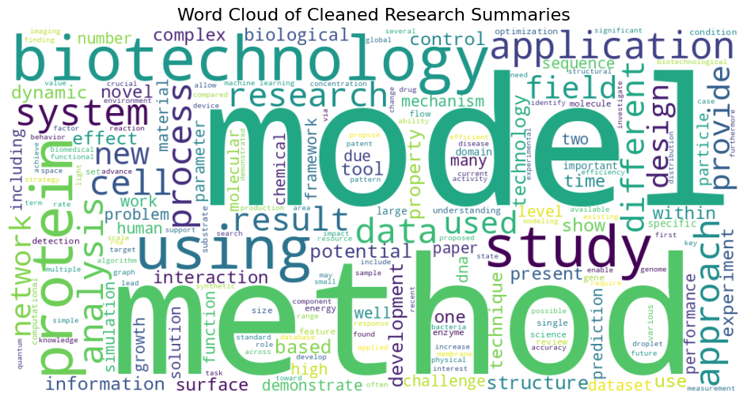
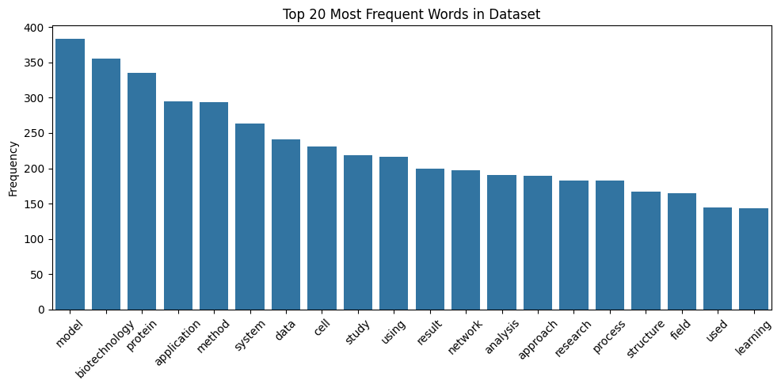
Data Visualization
Input: Biotechnology related documents
Query: protein structure using machine learning

Slide 10
Information Retrieval Techniques
BM25 (Lexical Matching) Ranks documents based on keyword frequency and inverse document frequency. Fast and widely used in academic IR.
FAISS (Facebook AI Similarity Search) Vector-based retrieval using document embeddings. Enables semantic similarity search.
Hybrid Retrieval Combines top-k results from BM25 and FAISS. Reduces the limitations of individual techniques.
Method | Type | Advantage | Limitation
BM25 | Lexical | Fast, Interpretable | No semantic meaning
FAISS | Semantic | Captures | May miss exact terms
Hybrid | Combined | Balanced Performance | Needs reranking

Slide 11
Query Expansion Strategy
Query Expansion Using LLMs
🔹Used FLAN-T5 and BERT to expand and rephrase user queries.
🔹Adds domain-specific synonyms and context-aware terms.
🔹 Enables matching with documents using different wording.

Slide 12
Challenges
Ensuring no duplication between BM25 & FAISS results
Semantic drift in large query expansions
Balancing latency vs accuracy
Lack of labeled relevance data for fine-tuning

Slide 13
Evaluation Methods
Precision@k Measures the proportion of relevant documents in the top-k results.
Mean Average Precision (MAP) Captures precision across all relevant documents and their ranks. Normalized Discounted
Cumulative Gain (nDCG@k) Measures the usefulness/relevance of documents based on their position.

Slide 14
Metrics
Precision@k is intuitive for top-k IR applications like academic search.
MAP rewards consistent ranking of relevant documents.
nDCG@k gives higher weight to top-ranked relevant documents (position matters).
Captures:
Accuracy
Ranking Quality
Relevance Order

Slide 15
Results and Analysis
Manually annotated top-5 documents for a sample of queries.
Each document labeled as relevant (1) or non-relevant (0).
BM25 and FAISS are outperformed by CORAG (Hybrid + Reranking).
Following query extension and reranking, there was a notable improvement in top-k accuracy and nDCG.
Method | Precision@3 | MAP | nDCG@5
BM25 | 0.40 | 0.60 | 0.75
FAISS | 0.50 | 0.68 | 0.80
Hybrid | 0.60 | 0.75 | 0.88
CORAG (Final)` | 0.66 | 0.91 | 0.96

Slide 16
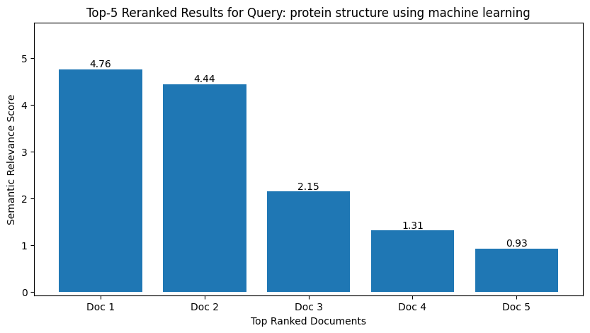
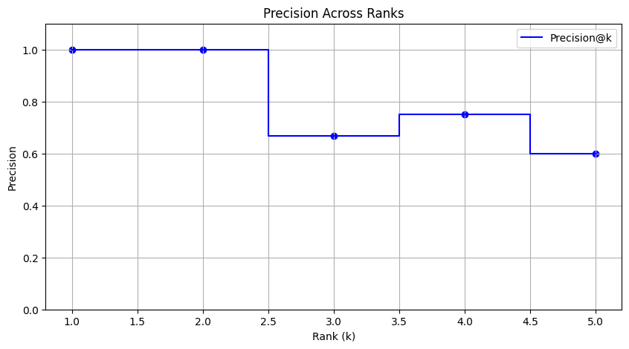
Results
Top Words Bar Chart Shows dominant keywords like model, biotechnology, protein. Helps align query expansion with common research terms. Precision@k Line Chart High precision at top-2 results. Quality slightly drops beyond rank 3.

Slide 17
Discussion
BM25 and FAISS are outperformed by CORAG (Hybrid + Reranking).
Following query extension and reranking, there was a notable improvement in top-k accuracy and nDCG.

Slide 18
Conclusion
CORAG connects semantic and lexical IR for scholarly research.
Improved ranking with hybrid reranking and retrieval.
Effective for extensive research datasets that are domain-specific.
Prompt orchestration and live, chunked PDFs can be used to expand CORAG to additional scientific disciplines.

Slide 19
References
S. Bruch et al., ”Efficient inverted indexes for approximate retrieval,” inProc. ACM SIGIR, 2024.
E. Vendrow et al., ”INQUIRE: A Natural World Text-to-Image RetrievalBenchmark,” arXiv preprint arXiv:2411.02537, 2024.
Z. Li et al., ”Attribute-driven Disentangled Representation Learning forMultimodal Recommendation,” in Proc. ACM MM, 2024.
Y. Tang et al., ”Caselink: Inductive graph learning for legal caseretrieval,” in Proc. ACM SIGIR, 2024.
K. Dhole et al., ”GenQREnsemble: Zero-shot LLM ensemble promptingfor generative query reformulation,” in Proc. ECIR, 2024.

